Slide 1
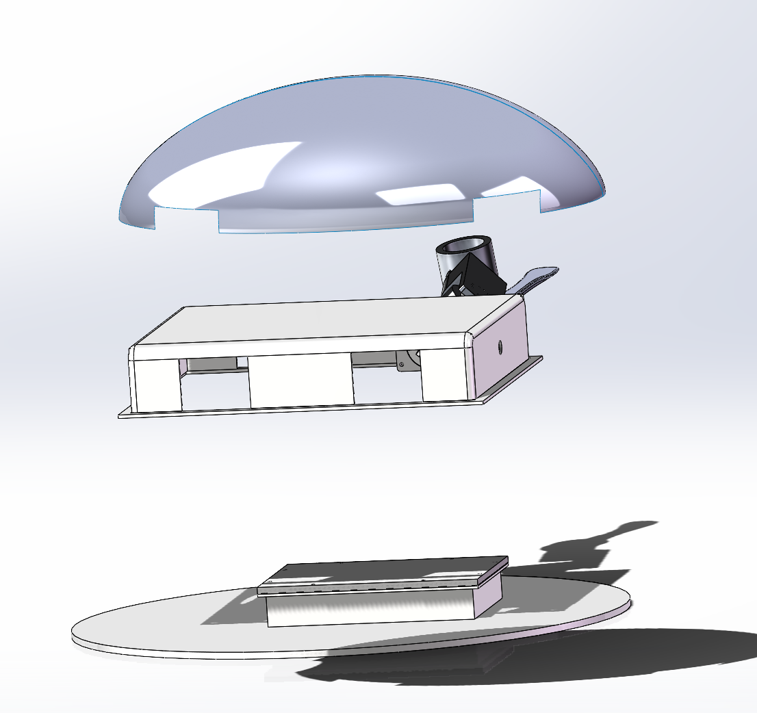
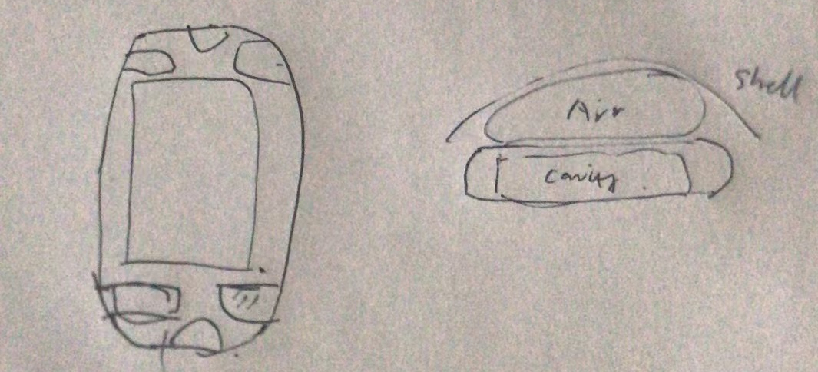
Cavity
Cavity design
1.Cavity is designed with three layers
2.The first layer holds all the development boards and batteries.
3.The second layer is where put the four motors for the arms and the two motors for the neck.
4.Placement of airbags between the second and third layers

Slide 2
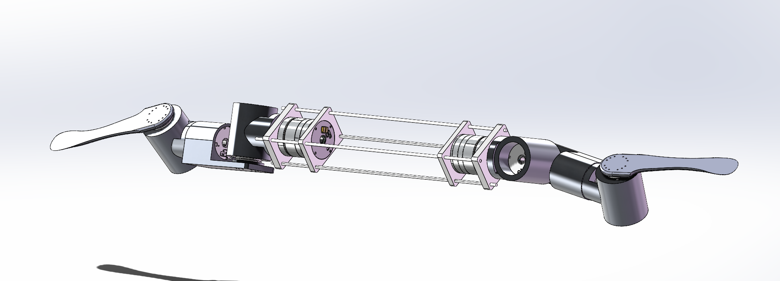
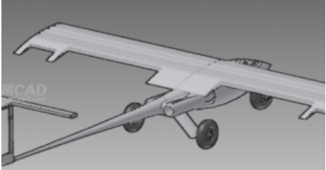
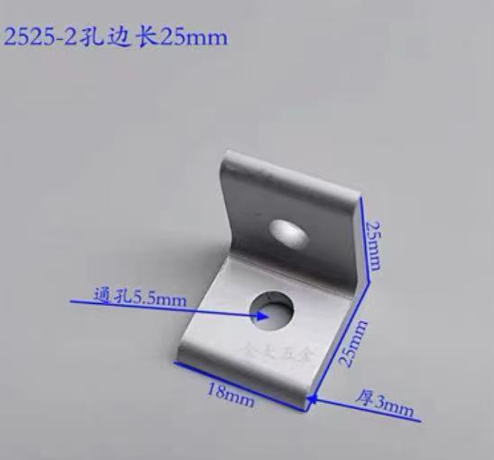
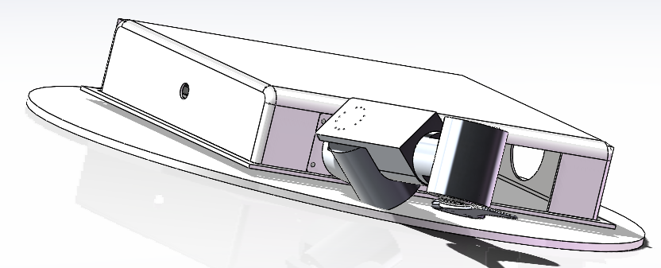
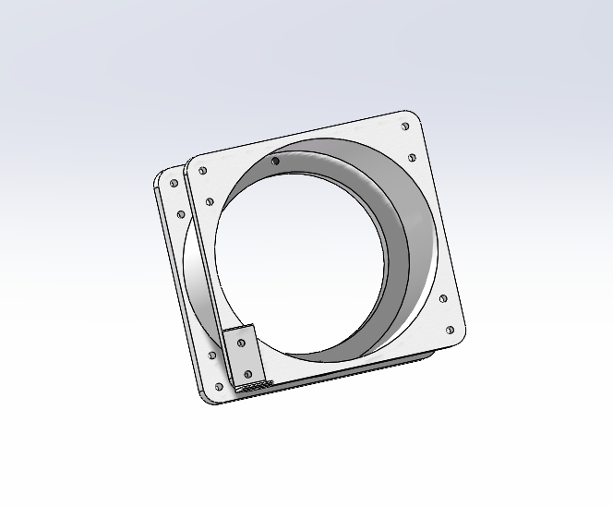
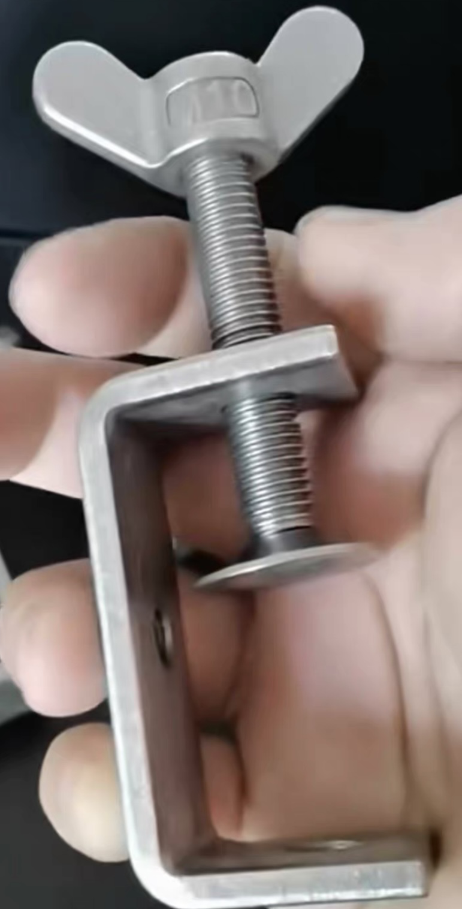
Cavity
Fixing method
1.Simulated aircraft skeleton
2.Secure the neck and limbs to the base plate with L-shaped standards
3.The development board is secured to the backplane with clamps

Slide 3
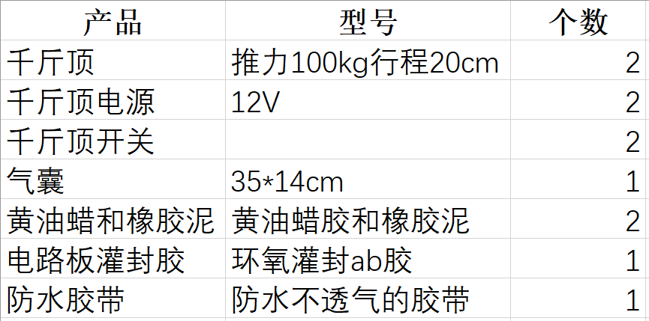
Cavity
Materials to be used in the cavity

Slide 4
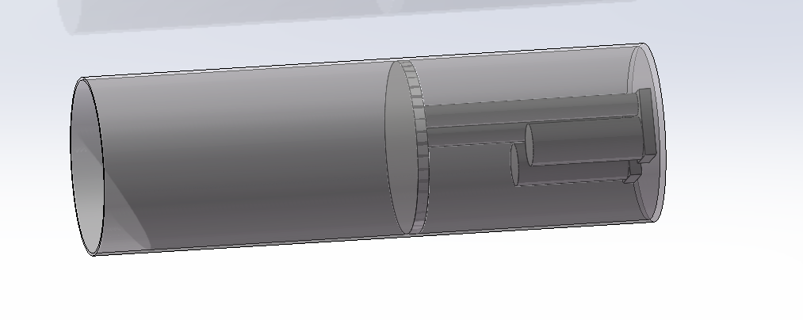
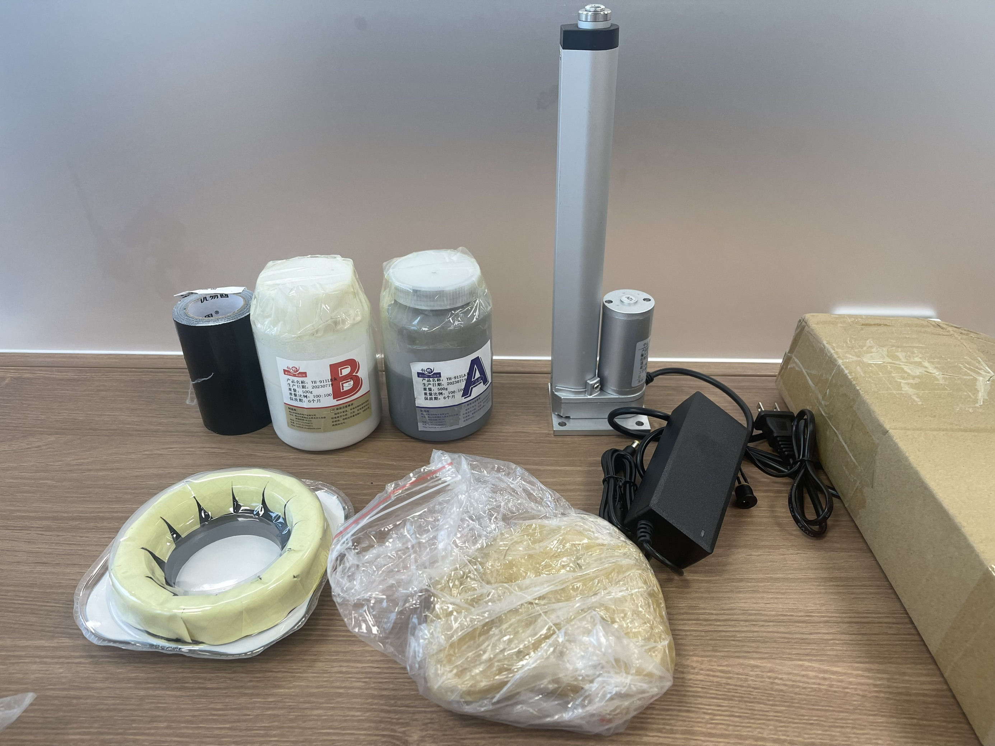
Cavity
Piston jack buoyant device design
Jack up the piston with two jacks to increase buoyancy

Slide 5
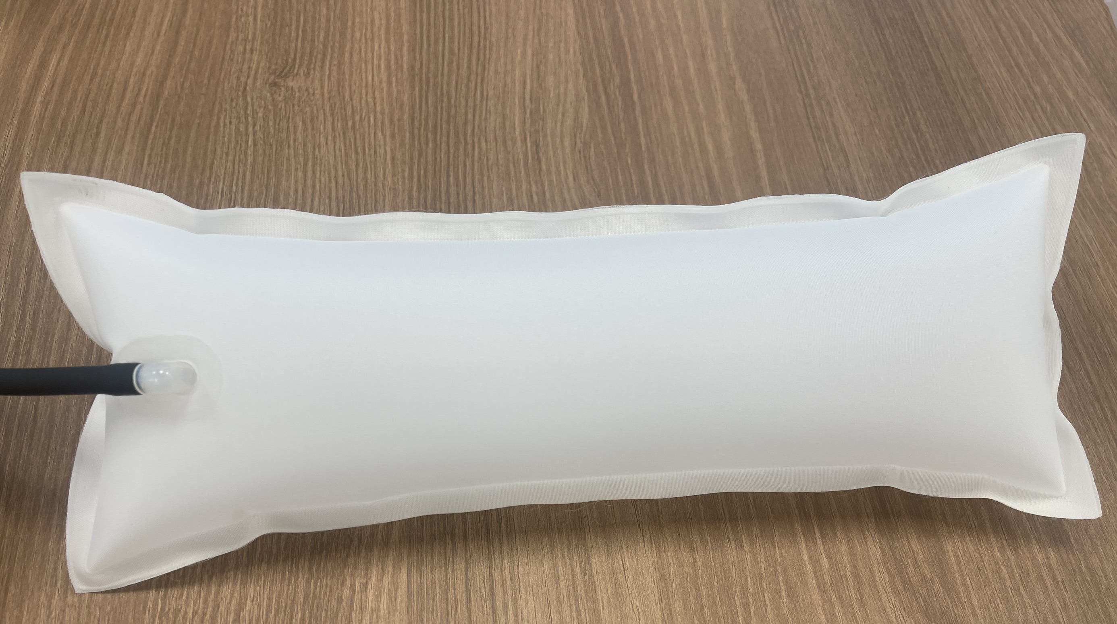
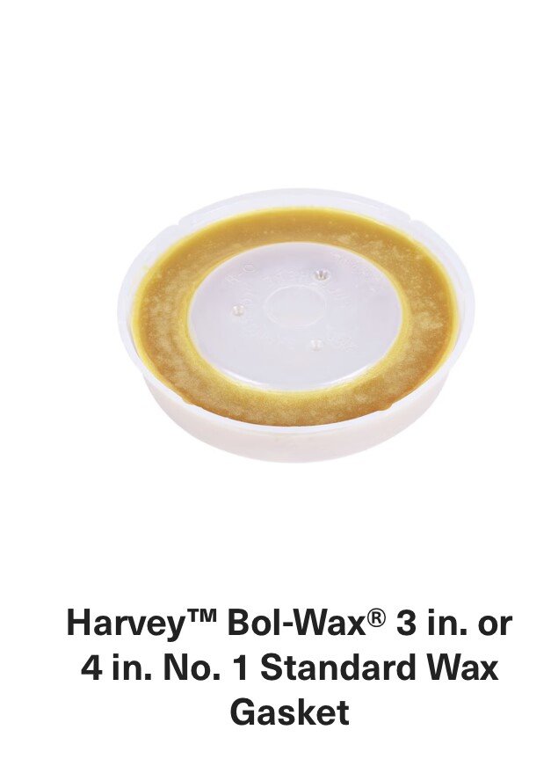
Cavity
Materials to be used in the cavity
1.Waxes
1.Flanged waterproof wax
2.Customized waterproof wax
2.Main airbag(customizable)
3.Circuit Board Potting Adhesive and Waterproof Tape

Slide 6
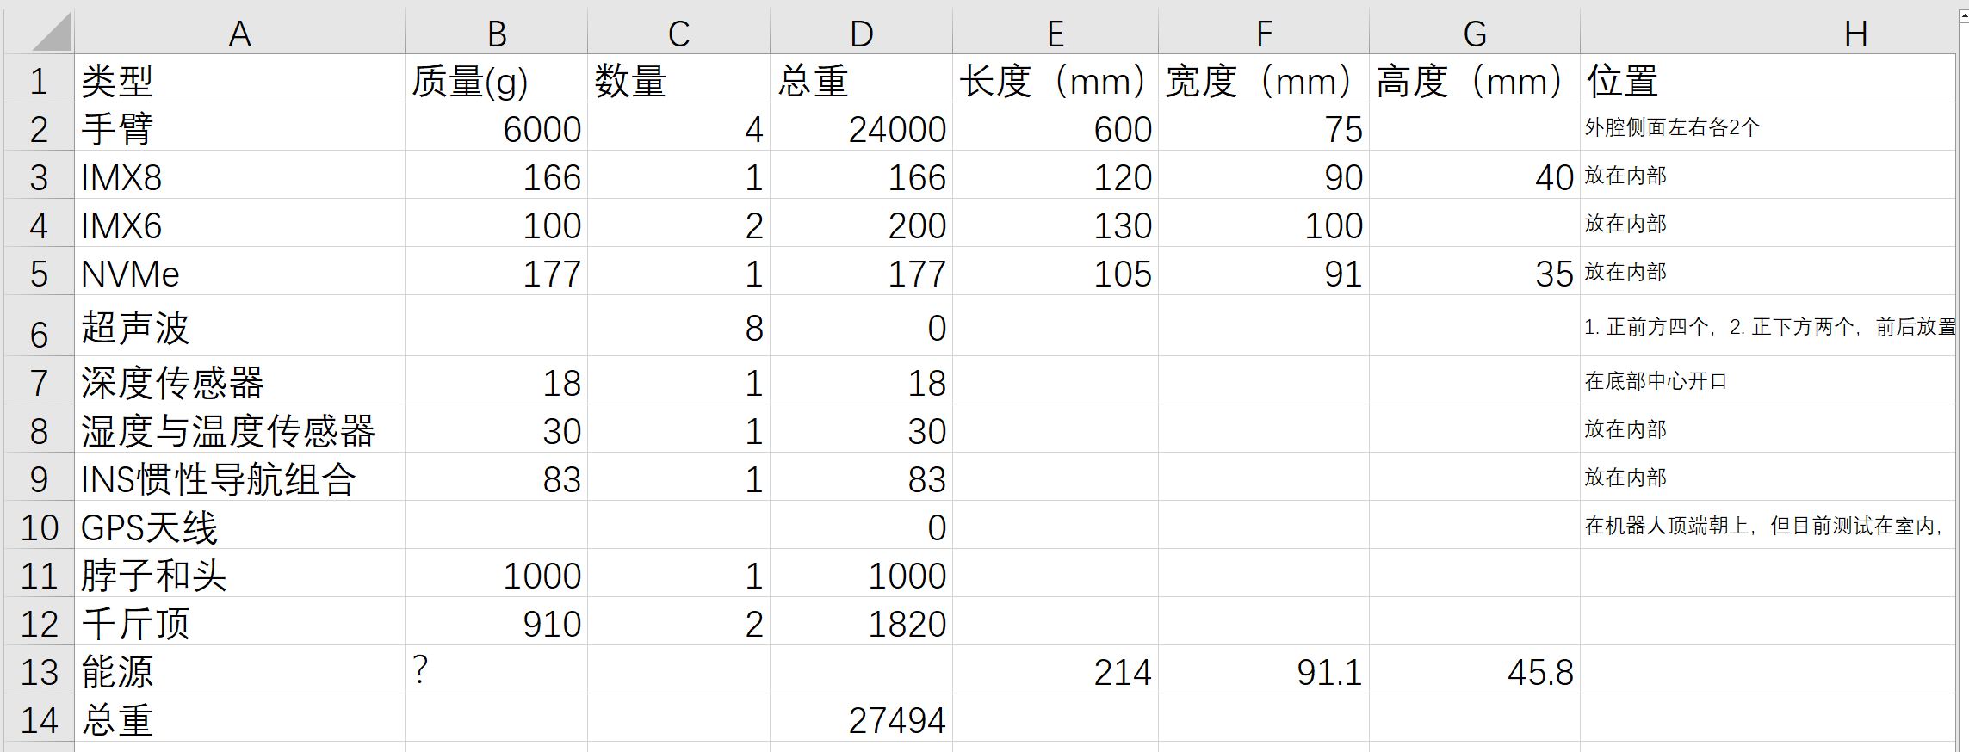
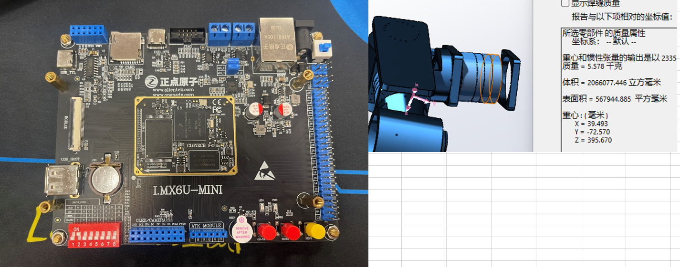
Cavity
All Turtle Parameters

